Slide 1

Apache Kura
Dima Ionut Daniel

Slide 2
Contents
What is Apache Kura?
What is OSGI ?
OSGI Architecture
Features
Architecture
Bibliography

Slide 3

What is Apache Kura?
Eclipse Kura aims at offering a Java/OSGI-based container for M2M applications running in service gateways.
Kura provides or, when available, aggregates open source implementations for the most common services needed by M2M applications.
Kura components are designed as configurable OSGI Declarative Service exposing service API and raising events.
Some of Kura components are in pure Java, others are invoked through JNI and have a dependency on the Linux operating system.

Slide 4
What is OSGI ?
OSGI (Open Services Gateway initiative) module system and service platform for the Java programming language that implements a complete and dynamic component model. Applications or components (bundles) can be remotely installed, started, stopped, updated and uninstalled without requiring a reboot.
OSGI enables the creation of highly cohesive, loosely coupled modules that can be composed into larger applications. Each module can be individually developed, tested, deployed, updated, and managed with minimal or no impact to the other modules.
The OSGI specification defines a deployment model for Java-based modules. The unit of deployment in OSGI is known as a bundle. A bundle can be installed, started, stopped, and uninstalled from the framework, following the life cycle prescribed by the OSGI specification.

Slide 5
What is OSGI ? (cont.)
OSGI also provides a service registry, with which bundles may publish and/or consume services. The services are known by their published interfaces, not by the implementation. This means that the coupling is kept low between service publishers and those that consume their services.
In OSGI each bundle is loaded into its own class space. This makes it possible for a bundle’s internal implementation to evolve without impacting other bundles that depend on its relatively stable public API.
OSGI bundles are discretely identified by a name (bundle’s symbolic name) and version number in the bundle’s manifest.
OSGI Specification Release 4 was first released in October 2005. Version 4.1 was released in May 2007. Core and Compendium Version 4.2 was released in September 2009. Enterprise Version 4.2 was released in March 2010. Core Version 4.3 was released in April 2011.

Slide 6
OSGI Architecture
The module layer doesn’t have any service API, but defines the modularization characteristics.
The security layer is based on Java 2 security architecture and defines how a bundle can be digitally signed and how security checks can be enforced in the context of the framework.
The life-cycle layer defines and manages the states an OSGI bundle can find itself in at any time. The transition of a bundle from each of these states is caused by either an administrative console or the framework performing dynamically based on what other actions are taking place in dependent bundles.
The service registry layer provides a cooperation model for bundles to share objects between bundles. A number of events are defined to handle the coming and going of services.
The service Layer is a Java object inside a bundle, which is listed in an OSGI service registry for the benefit of other bundles running in the same JVM. The bundle can register a service, it can search for a service, or it can receive notifications when a service changes.

Slide 7
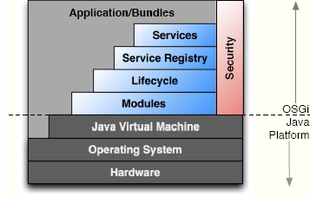
OSGI Architecture (cont.)

Slide 8
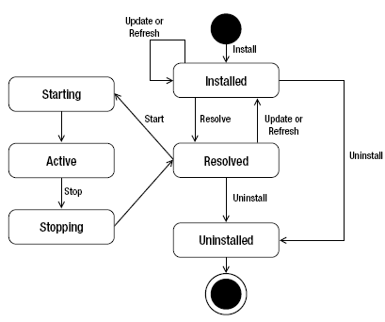
OSGI Architecture (cont.)
Installed → a bundle has been validated and is prepared to be activated.
Resolved → all dependencies declared for a bundle have been resolved.
Starting → a bundle is in the process of transitioning to an active state.
Active → a bundle has been loaded into the actual JVM footprint.
Stopping → bundle is in the process of being stopped.
Uninstalled → a bundle is effectively uninstalled, meaning no verification process has taken place.

Slide 9
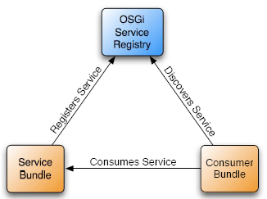
OSGI Architecture (cont.)
OSGI bundles can both publish and consume services (like an SOA in a JVM).

Slide 10
Features
I/O Services
Data Services
Cloud Services
Configuration Service
Remote Management
Networking
Watchdog Service
Web administration interface

Slide 11
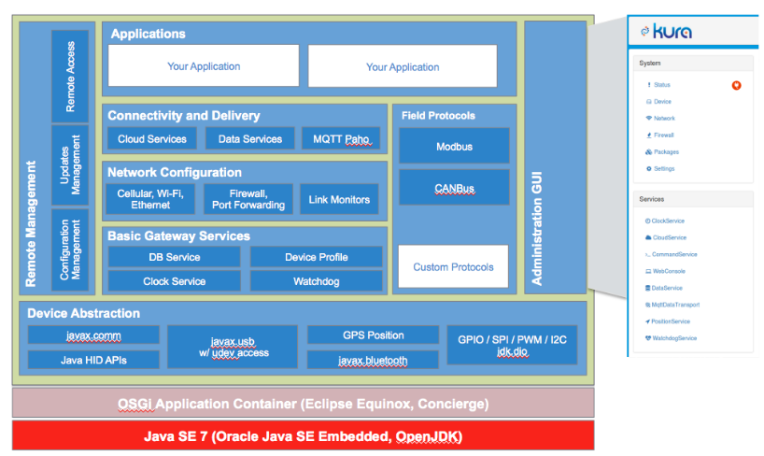
Architecture

Slide 12

Bibliography
http://wiki.eclipse.org/Kura
http://www.eclipse.org/kura/

